Slide 1
KAVEEN VIGNESH T K
Final Project

Slide 2
PROJECT TITLE
IDENTIFYING RISK FACTOR FOR HEART DISEASE USING CNN ALGORITHM

Slide 3


AGENDA
Introduction to heart disease
Dataset Description
Introduction to CNN algorithm
Model Architecture
Model Training and Testing
End users and wow in solution
output for model
Results
3/21/2024 Annual Review

Slide 4

PROBLEM STATEMENT
We want to find better ways to spot things that might cause heart problems. Right now, the methods we use aren't very accurate or fast. We think using something called Convolutional Neural Networks, kind of like how computers see pictures, could help. So, we're going to use these networks on a bunch of heart data to try and make a prediction program that can find and understand what things might cause heart issues. Hopefully, this will help doctors catch problems early and figure out ways to prevent them.

Slide 5

PROJECT OVERVIEW
We're using a bunch of data about people's hearts, like blood pressure level and sugar level, and teaching computers to look at them using something called Convolutional Neural Networks (CNNs). These networks are like smart filters that can find patterns in the data. By doing this, we hope to find out what things in these heart data might lead to problems. Then, we can use this information to help catch issues early and come up with personalized plans to keep people healthy. Our project aims to use these advanced computer methods to improve how we predict and prevent heart disease.

Slide 6
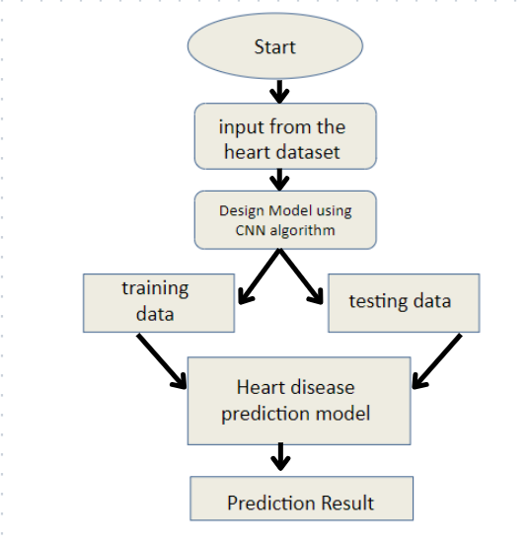
Architecture diagram

Slide 7
WHO ARE THE END USERS?
Healthcare Providers:
Physicians, cardiologists, and other healthcare professionals can utilize the system to assist in the early detection and diagnosis of heart disease in patients.
Healthcare Institutions:
Hospitals, clinics, and medical centers can integrate the system into their diagnostic workflows to improve the accuracy and efficiency of heart disease risk assessment.
Health Insurance Companies:
Insurance companies can use the system to assess the risk profiles of policyholders and offer personalized health management programs to reduce the incidence of heart disease and related healthcare costs.
Patients and Caregivers:
Individuals at risk of heart disease, as well as their caregivers and family members, can benefit from the system's ability to provide personalized risk assessments and recommendations for lifestyle modifications and preventive measures.

Slide 8

YOUR SOLUTION AND ITS VALUE PROPOSITION
Early Detection:
By leveraging advanced machine learning techniques, the system can identify subtle patterns and risk factors in heart data, enabling early detection of potential heart issues before they escalate.
Improved Accuracy:
CNN algorithms excel at pattern recognition and feature extraction, leading to more accurate risk assessments compared to traditional methods, which may rely on manual interpretation of data.
Personalized Intervention:
The system's ability to analyze individualized heart data allows for the creation of personalized intervention strategies tailored to each patient's specific risk factors and health profile.

Slide 9

THE WOW IN YOUR SOLUTION
Time and Resource Efficiency:
Automating the risk assessment process with CNNs streamlines workflow for healthcare providers, saving valuable time and resources while ensuring timely and proactive patient care.
Transformative Healthcare Impact:
By enhancing early detection and prevention strategies for heart disease, our solution has the potential to significantly improve healthcare outcomes, reduce healthcare costs, and ultimately save lives.
Personalized Precision:
Unlike one-size-fits-all approaches, our solution offers personalized risk assessments and intervention plans tailored to each individual's unique health profile, maximizing the effectiveness of preventive measures.
3/21/2024 Annual Review

Slide 10
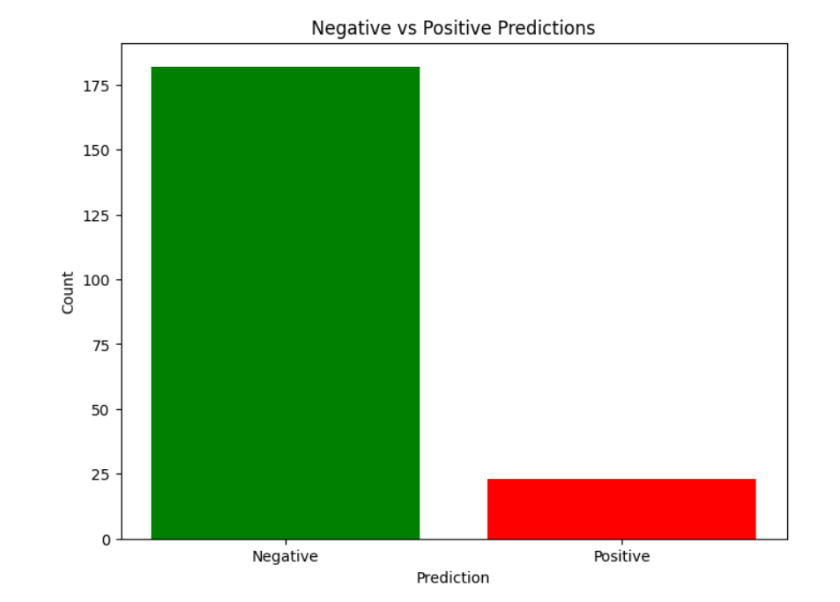
FINAL OUTPUT

Slide 11
RESULTS
Cost Savings:
Early detection and intervention lead to cost savings for healthcare systems by reducing the need for expensive treatments and hospitalizations associated with advanced stages of heart disease.
Early Detection:
Patients at risk of heart disease are identified at an earlier stage, allowing for timely intervention and preventive measures to be implemented before serious complications arise.
Improved Accuracy:
The CNN algorithm accurately identifies subtle patterns and risk factors in heart data, resulting in more precise risk assessments compared to traditional methods.

